Slide 1
Destination
Australia
General Presentation

Slide 2
Why Australia
International Rankings of Australian Universities
Part time job opportunities for international students
Post-Study Work Visa up to 5 years
Opportunity for Permanent Residence
IELTS, TOEFL and PTE scores are accepted by all universities
Availability of pathway programs for international students

Slide 3
Why Australia
No application fee in a majority of universities
Flexibility in terms of deadlines, universities ready to accept applications and financials closer to course start dates
Lower entry requirements of universities with relatively higher international rankings
No Visa interviews
Quick visa outcomes*
GST is paid over and above commissions

Slide 4
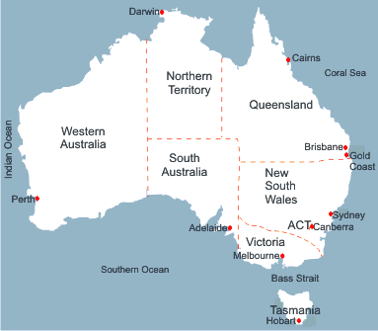
Australian States and Capitals

Slide 5
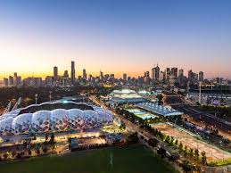
Popular cities in Australia
Sydney
Melbourne
Brisbane
Adelaide
Perth

Slide 6
Intakes available with Australian Universities
Major Intakes
February and July
Offered by Universities and Private Colleges
Courses offered: All popular areas
Minor Intake
October/November
Offered by Private Colleges and some of the major universities
(e.g. Deakin University and Griffith University)
Courses offered: Business, Information Technology and Engineering

Slide 7
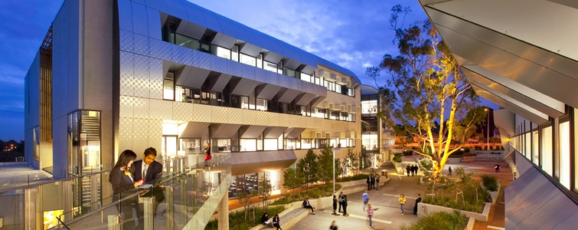
Types of Educational Institutions in Australia
Private Colleges
Universities

Slide 8
Private Colleges in Australia
Colleges offering Bachelor's and Master's programs
Independent Colleges offer Bachelor’s & Master’s Degrees
Some colleges are affiliated with universities (offer UG & PG programs)
These colleges offer Information Technology and Business programs

Slide 9
Private Colleges in Australia
Colleges offering Pathway programs
These Colleges offer ELICOS and Diploma leading to Degree programs
Programs are offered in almost all popular disciplines such as IT, Engineering, Health, Business, Hospitality, etc.

Slide 10
Universities in Australia
There are a total of 43 Universities in Australia
Public – 38 Universities
Private – 3 Universities
The Higher Education Sector in Australia primarily consists of Universities
The top 8 universities in Australia are popularly known as Group of 8
Australian Universities offer pathway programs, bachelor’s & master’s degrees and doctoral programs

Slide 11
Programs offered by Australian Universities
Pharmacy
Business, Management & Accounting
IT & Computer Science
Architecture & Urban Planning
Hospitality & Tourism
Programs offered by Universities
Media & Communication
Engineering & Project Management
Biotechnology & Biomedical Sciences
MBBS, Nursing & Public Health
Education & Teaching

Slide 12
Pathway Programs
Students who are not able to meet the direct entry requirements of Australian Universities can be offered ‘Pathway Programs.’
These programs can be offered at undergraduate level and postgraduate level.
These are also called as ‘Packaged Programs’.
Pathway programs are a good opportunity to the students who fail to meet the direct entry requirements of the Australian universities.

Slide 13
Types of Pathway Programs
Pathway Programs are of two types
Academic Pathway Programs
Offered to the students not able to meet the Academic entry criteria
English Language Programs
Offered to the students not able to meet the English language criteria

Slide 14
Academic Pathway Programs
(Undergraduate)
Students scoring 55% to 64% in HSC can be offered these programs
They are also called as Diploma leading to Degree programs (D to D programs)
Students usually get admission in a college where they study a Diploma Program for one year (e.g. Diploma of Business)
After successful completion of Diploma, they progress to the second year of Bachelor’s degree, eventually completing their graduation in 3/4 years.

Slide 15
Explanation of Academic Pathway Programs
(Undergraduate)
Student A - 60% in HSC
(Directly not eligible)
Student B - 75% in HSC
(Directly eligible)
Studies Diploma of Business in a college in his 1st year
Studies Bachelor of Business in the university in his 1st year
Both of them will progress to study the second year of Bachelor of Business in the university
They graduate together eventually

Slide 16
Academic Pathway Programs
(Post-graduate)
Some Australian universities offer pathways at postgraduate level.
Offered to the students who fail to meet NOOSR criteria
e.g., Second division from a Section 3 university/Pass division from a Section 2 university.
Students are offered a qualifying program of one semester called as PQP
Student first completes the PQP and then progresses to the master’s degree
PQPs are available only for business/management/accounting degrees
(Exception: Griffith University offers PQP for business, engineering and IT courses

Slide 17
English Language Pathways (ELICOS)
English Language Pathways are also called as ELICOS, EAP, ELP, etc.
Offered to students falling short of English language requirement
Students have to study English ‘before’ commencing their main program
Duration of ELICOS is restricted to 10 weeks
Tuition Fee of ELICOS: AUD 300 to AUD 400 per week

Slide 18
Time schedule for Australia processing
For February intake
IELTS Coaching | June
Appear for IELTS Test | July
IELTS Test Result | July/August
Submit applications to universities | July to October
Offer Letters | July to November
Arrangement of Funds | August to December
Financial Assessment in the Universities | September to January
Apply for Visas | October to January
Visa Grant | December to February
Fly to Australia | February

Slide 19
Time schedule for Australia processing
For July intake
IELTS Coaching | December
Appear for IELTS Test | January
IELTS Test Result | January/February
Submit applications to universities | January to April
Offer Letters | January to May
Arrangement of Funds | February to May
Financial Assessment in the Universities | March to May
Apply for Visas | May to June
Visa Grant | April to July
Fly to Australia | July

Slide 20
Annual Cost of education and living in Australia
Particulars | Amount in AUD
Tuition Fee of Universities | AU$ 30,000
Living Costs | AU$ 21,041
Airfare from India to Australia | AU$ 2,000
Visa Fee | AU$ 640
Total Expenses | AU$ 53,681
Less Part Time Earnings | AU$ 15,000
Net Cost | AU$ 38,681
Less Scholarship Amount | If Applicable
Total Money to be spent by the student | AU$ 38,681

Slide 21
Why Australia with Academic Monk
A good mix of universities, colleges and study centers catering to all types of students (rankings, eligibility and budget preferences)
Consistently high visa success ratio over the last 2 years
Experienced staff members providing end-to-end support
Assistance for interviews and SoPs

Slide 22
Thank You!

